Slide 1
The Neurodivergent Community: Strategies to Address Mental Health
Melissa Blackmer, MBA, LMFT, LMHC
Kelsey Darmochwal, LMHC, NCC

Slide 2
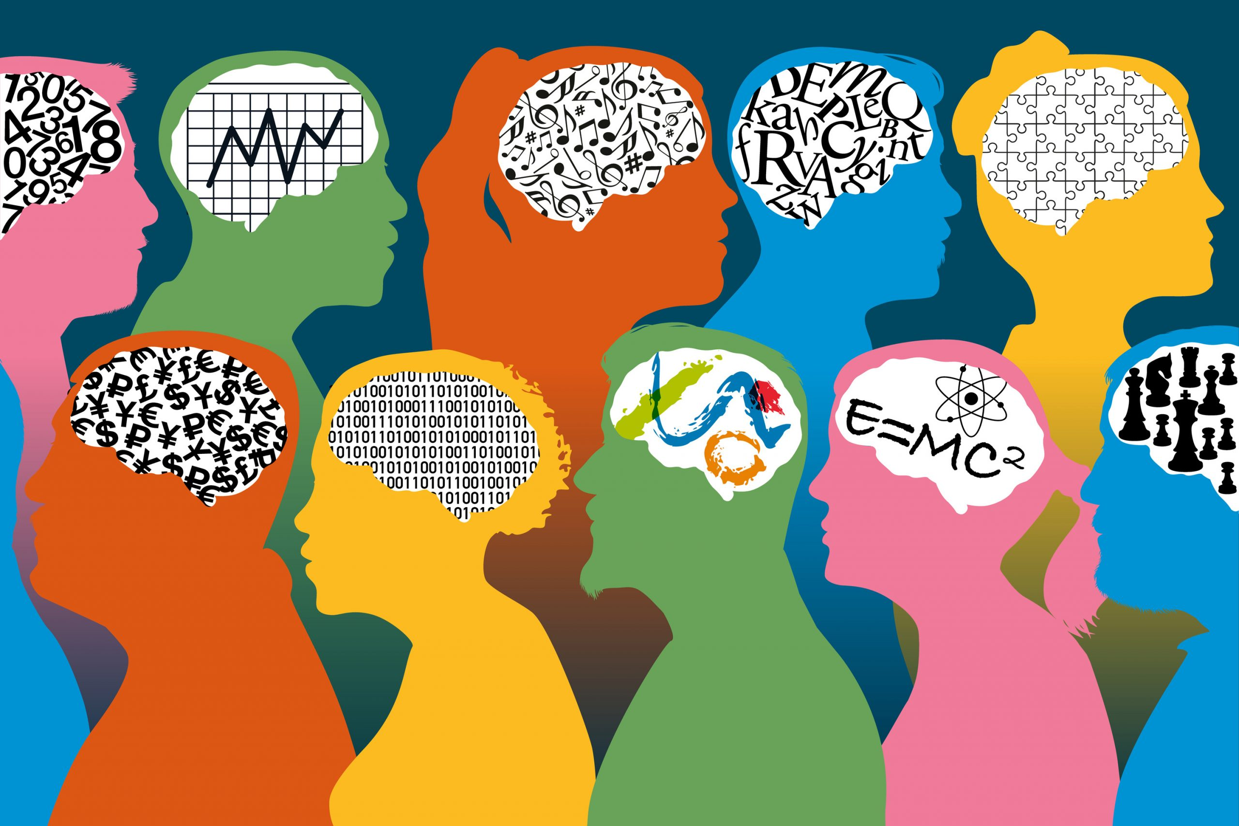
What is Neurodiversity?
Neurodiversity is a non-medical term used to describe the range of differences in individual brain function and behavioral traits, regarded as part of normal variation in the human population. It includes more than it excludes!
A Neurodivergent person is one who thinks in a way that differs from the norm.
A Neurodiverse group includes people of different neurotypes.
A Neurotypical person is one whose brain works in a typical manner.

Slide 3
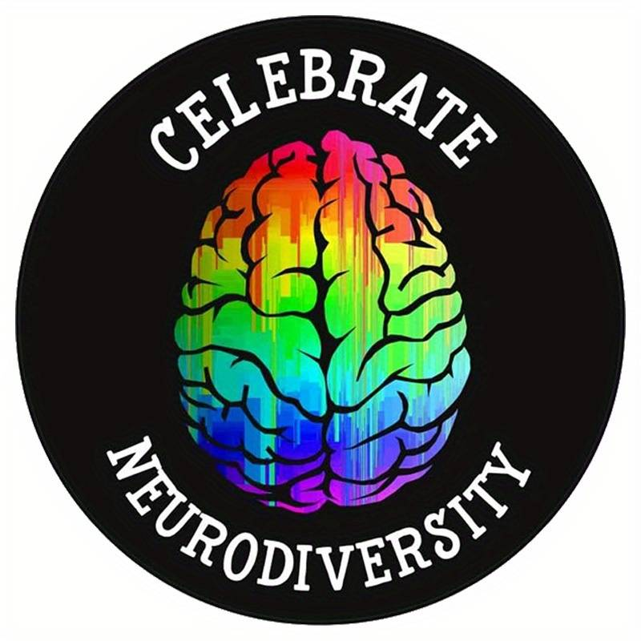
Neurotypes
Autism Spectrum Disorder (ASD)
Attention Deficit Hyperactivity Disorder (ADHD)
Tourette’s Syndrome
Intellectual Disability
Specific Learning Disabilities
Sensory Processing Disorder (SPD)
Giftedness
OCD

Slide 4
OCD as Neurodivergence
Characteristics often linked with neurodivergence | Does OCD align with these characteristics?
Challenges in social interaction | Typically Yes
Difficulty adapting or shifting interests | Typically Yes
Sensory processing differences | Typically Yes
Preference for routines and rituals | Typically Yes
Unique pattern recognition skills | Typically Yes
Diverse creativity and expression | Typically Yes
Intense focus on individual interests | Typically Yes

Slide 5
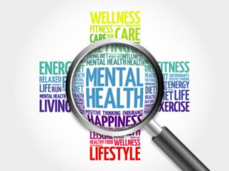
Mental Health Challenges
Anxiety
Depression
ADHD/Impulsivity
Sensory Overload
Executive Functioning Deficits
Social Isolation and Loneliness
Emotional Regulation Issues
Notes:
Anxiety Disorders: Neurodiverse individuals may experience heightened levels of anxiety, including generalized anxiety disorder, social anxiety disorder, and specific phobias.
Depression: Feelings of sadness, hopelessness, and low mood can affect neurodiverse individuals, sometimes as a result of social challenges or difficulties in navigating the world.
Attention Deficit Hyperactivity Disorder (ADHD) and Impulsivity: ADHD is often associated with difficulties in focusing, impulsivity, and hyperactivity, which can lead to challenges in daily functioning and self-esteem.
Sensory Overload: Many neurodiverse individuals experience sensory processing difficulties, leading to sensory overload in environments with excessive stimuli. This can trigger anxiety, panic attacks, or meltdowns.
Executive Functioning Challenges: Difficulties with executive functioning, such as organization, planning, and time management, can lead to stress and frustration, impacting mental well-being.
Social Isolation and Loneliness: Challenges in social interactions and communication can contribute to feelings of isolation and loneliness, which in turn can negatively impact mental health.
Emotional Regulation: Neurodiverse individuals may struggle with regulating their emotions, leading to difficulties in managing stress, anger, or frustration.

Slide 6
Missy will ask Kelsey some questions

Slide 7
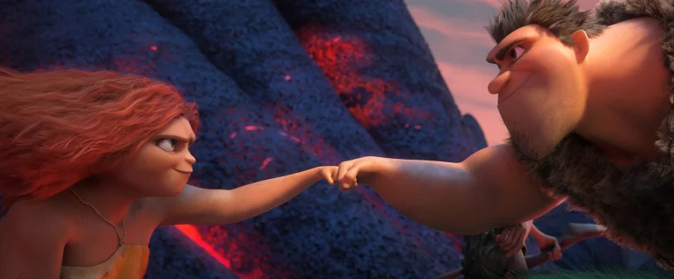
Why is Neurodiversity a good thing?
Creativity and ability to think outside the box.
Heightened goal-directedness
Ability to problem solve
The Curb-Cut Effect.
Eep and Her Father
The Croods

Slide 8
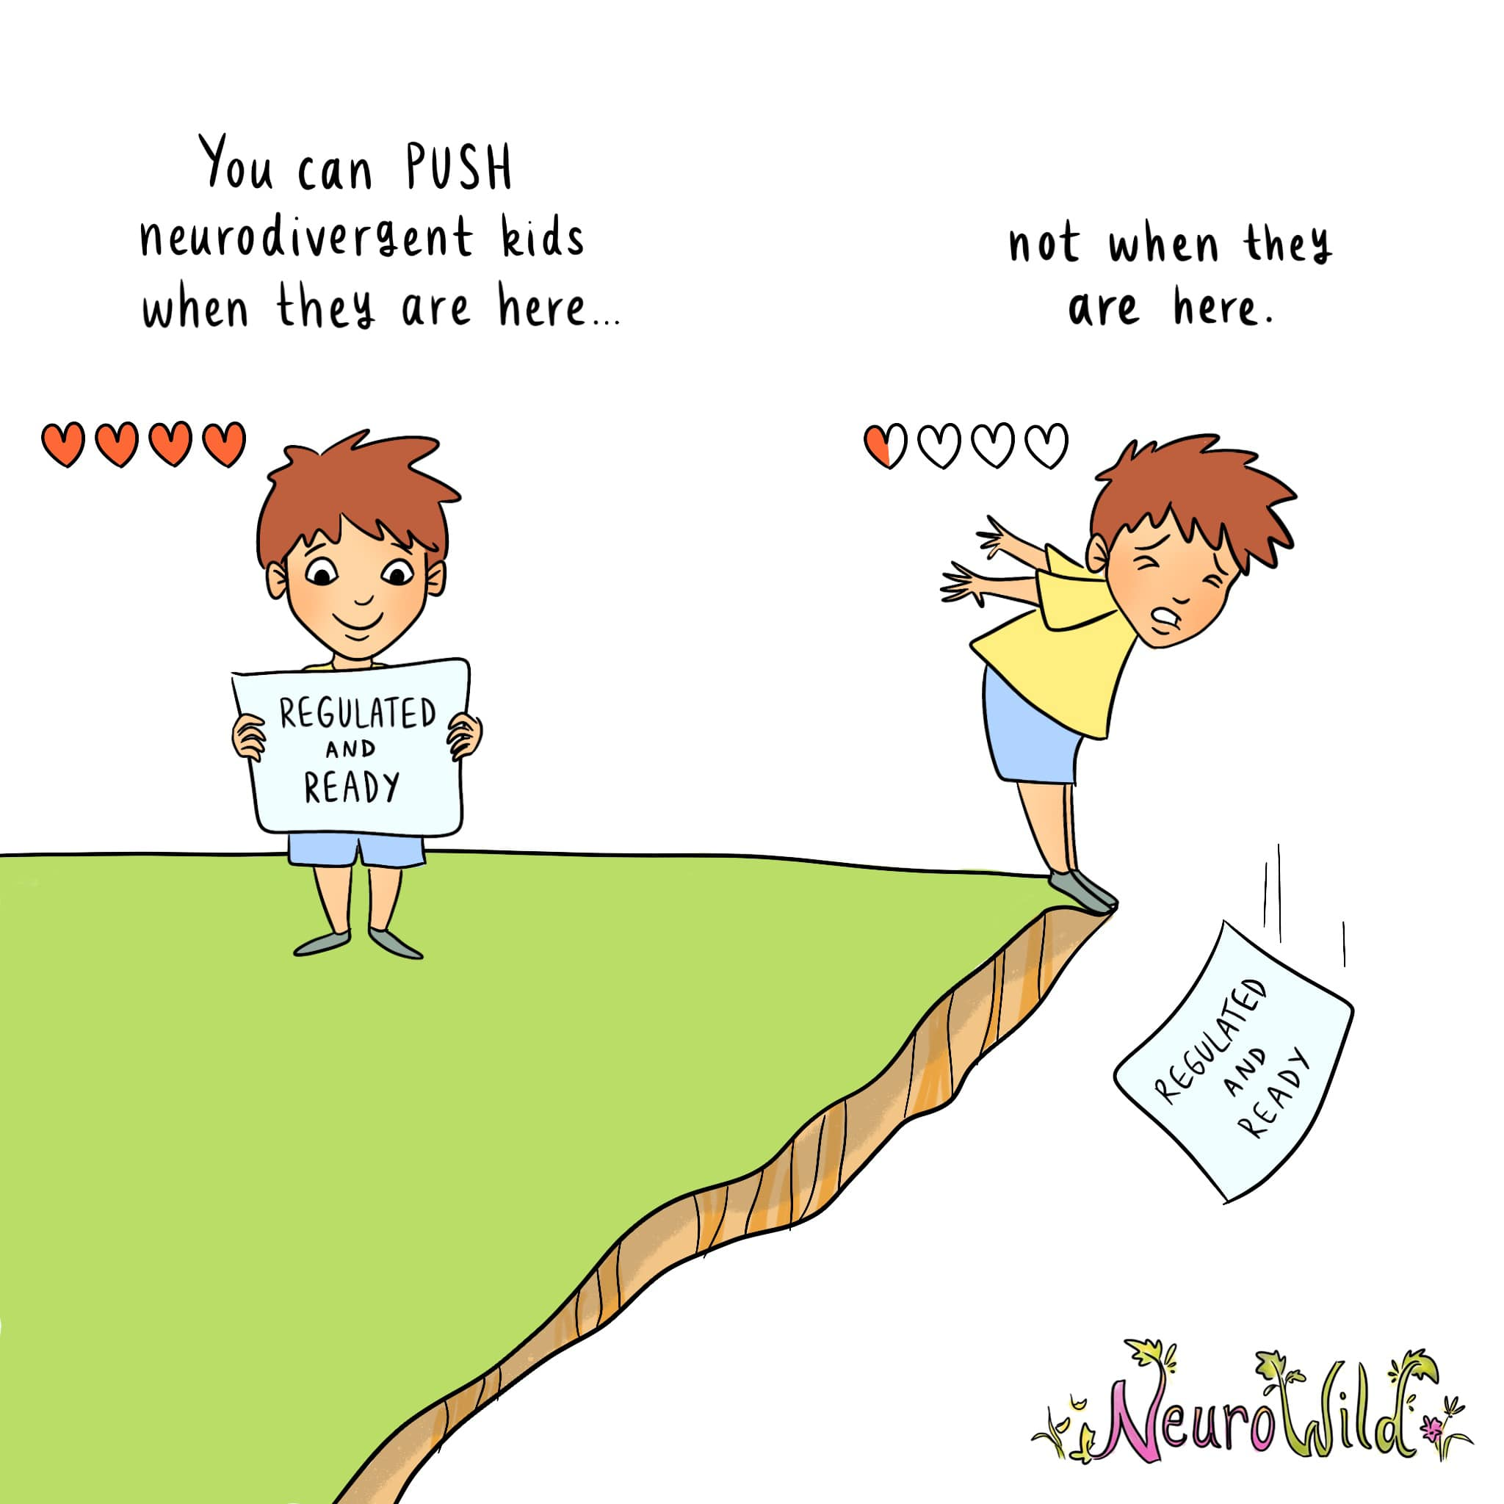
Why Professionals Need Training
Many therapeutic techniques can be harmful to a ND individual if not properly applied!
Neurodivergent Burnout needs to be treated differently from depression. (capacity vs capability)
With depression, behavioral activation helps to reduce symptoms.
In autistic burnout, the individual is lacking the capacity to complete ADLS and needs to work on “recharging” their capacity first. Behavioral activation with further drain their capacity.
Notes:
Sensory issues that are draining the battery too much and too fast and they can’t learn the new habits or have depression relief.

Slide 9
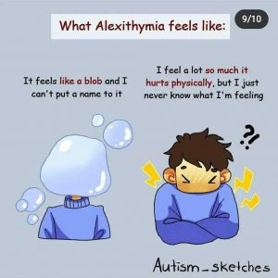
Alexithymic
trouble experiencing, identifying and describing emotions – they present as an over or underwhelming sensation that is hard to differentiate from other feelings
Current estimates are 70% of Autistic and 1 in 10 in the general population
Notes:
Anxiety Disorders: Neurodiverse individuals may experience heightened levels of anxiety, including generalized anxiety disorder, social anxiety disorder, and specific phobias.
Depression: Feelings of sadness, hopelessness, and low mood can affect neurodiverse individuals, sometimes as a result of social challenges or difficulties in navigating the world.
Attention Deficit Hyperactivity Disorder (ADHD) and Impulsivity: ADHD is often associated with difficulties in focusing, impulsivity, and hyperactivity, which can lead to challenges in daily functioning and self-esteem.
Sensory Overload: Many neurodiverse individuals experience sensory processing difficulties, leading to sensory overload in environments with excessive stimuli. This can trigger anxiety, panic attacks, or meltdowns.
Executive Functioning Challenges: Difficulties with executive functioning, such as organization, planning, and time management, can lead to stress and frustration, impacting mental well-being.
Social Isolation and Loneliness: Challenges in social interactions and communication can contribute to feelings of isolation and loneliness, which in turn can negatively impact mental health.
Emotional Regulation: Neurodiverse individuals may struggle with regulating their emotions, leading to difficulties in managing stress, anger, or frustration.

Slide 10
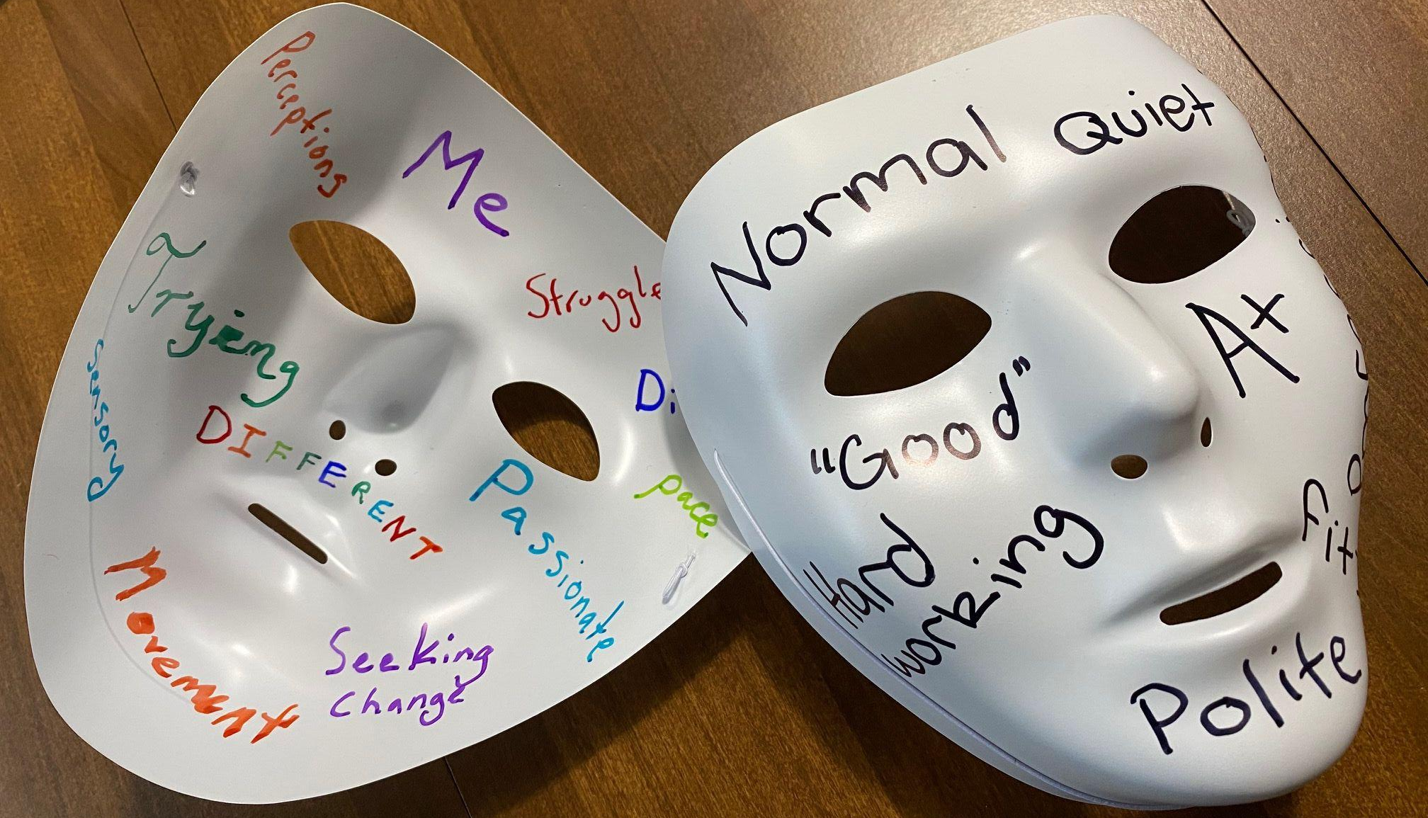
What is Masking?
Masking, or camoflaging, is suppressing natural personality traits or symptoms of neurodiversity to conform to societal norms and/or avoid ostracism or abuse. It is a largely unrecognized protective device developed over a person’s lifetime.
Many ND individuals are not consciously aware of masking behaviors.
Consider the experience of your first job interview. What did you so or say differently in that context versus when you are with a trusted friend?
Notes:
Masking is usually a survival skill that’s automatic
Need to learn how to make it a tool
If you mask all the time, you don’t form relationships. You’re not really yourself and it’s exhausting.
As professionals, we don’t want to be telling people to mask up and be ok with it.

Slide 11
What is Unmasking?
Research and experience demonstrate that Neurodivergent (ND) peer to peer communication is highly effective.
Neuroptypical (NT) social skills vary from ND social skills, and both are valid ways to communicate.
The double empathy problem is in part why there is communication struggles in ND and NT communication.
Unmasking is often an important part in healing anxiety, depression, burnout, and other comorbid mental health concerns.

Slide 12
The Importance of Authentic Self
When authentic self is suppressed, relationships are suppressed, love and belonging needs are not met, and ND individuals express feeling “lost”, “alone”, “misunderstood”, and “broken.”
Having others show interest in your interests and ideas is very important, but there are less opportunities for this to occur in day-to-day settings, especially as IQ increases. Helping students get connected with others who can engage with them is vital for gifted and profoundly gifted teens.

Slide 13
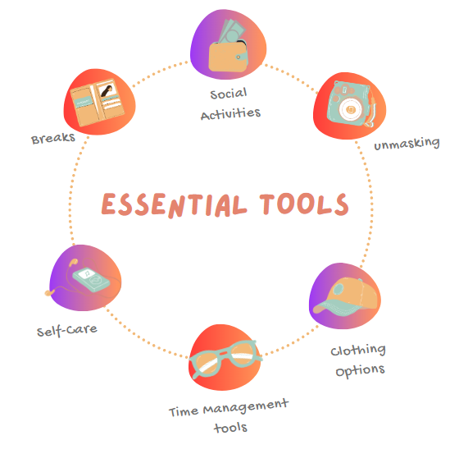
Masking can be a tool in the toolkit – but it can’t be the only one
Masking is a survival tool, and in some situations our world is not yet safe for an unmasked ND individual. ( Keep advocating everyone!)
Masking is linked with increased time in fight/flight/freeze, decreased connection, distancing from coping skills that work, decreased in self-esteem, eating disorders and suicide.
Being able to CHOOSE when they mask or be themselves is a crucial part of reducing trauma for ND individuals.

Slide 14
Neurodivergent Affirming Care
Social skills and EF should not be where we start!
ND affirming care starts with psychoeducation of their neurotype. Helping them understand why their brain is wired different so they have more space and grace for themselves.
Sensory accommodations and modifications.
Emotional psychoeducation and awareness, especially for Alexithymic clients and their family members.

Slide 15
Neurodivergent Affirming Care
Exploration of coping skills AND distress tolerance skills
Exercise
Ice packs
Big body movements
Once an individual is able to manage these aspects, then social skills, self-advocacy skills, and executive functioning strategies will start to improve.
Social skills and EF should not be where we start!

Slide 16
Neurodivergent Affirming Care
Social Skills for ND
Info dumping
Mindful sharing (this is how I’m enjoying this activity but be aware and ask “would you like me to continue?”)
Being present without engaging in the same activity as someone else
Awareness and consent about touch
Self-advocacy
Reading the room – Is this sensory safe? Am I here for a specific goal? Can I manage this need on my own in some way? If I can’t, I can leave the space or ask for help
App – Goblin Tools

Slide 17
How to give back control to ND clients
They are the experts of their own lives! Listen to their goals and concerns.
Make observations of masking behavior
Encourage self-exploration
Encourage personal strengths
Challenge your own personal bias to avoid pushing abelism onto your client
Have affirming conversations around diversity and neurodiversity
Ask “Who, why, when” questions about behaviors and how they change in different settings

Slide 18
Contact Us
Missy Blackmer, LMFT, LMHC
Unboxed Grace Counseling Co.
missy@thementalhealthchick.com
TMHC Coaching & Consulting
missyjane@thementalhealthchick.com
Call or Text
260-225-8077
for more information
Kelsey Darmochwal, LMHC, NCC, ASDCS, ADHD-CCSP
Positive Perceptions, LLC
Kelsey @positiveperceptionstherapy.com
Call or Text
(260) 267-0234
for more information

Slide 19
Recommended Readings:
Divergent Mind - Jenara Nerenberg
Neurotribes - Steve Silberman
The #ActuallyAutistic Guide to Advocacy- Jennifer Brunton Ph.D and Jenna Gensic M.A.
A Therapist’s Guide to Neurodiversity Affirming Practice with Children and Young People- Raelene Dundon
Unmasking Autism - Devon Price
The Happiness Trap Illustrated - Russ Harris
The Neurodivergent Friendly Workbook of DBT Skills- Sonny Jane Wise
Surviving And Thriving with Aspergers- Danny Raed
Your Child is Not Broken: Parenting Your Neurodivergent Child without Losing Your Marbles: Heidi Mavir
Raising Human Beings - Dr. Ross Greene

Slide 20
Sources
Cook, A., Ogden, J., & Winstone, N. (2018). Friendship motivations, challenges and the role of masking for girls with autism in contrasting school settings. European Journal of Special
Needs Education, 33(3), 302–315. https://doi.org/10.1080/08856257.2017.1312797
Verity Chester (2019) “Autistic women and girls: increasingly recognized, researched and served”, Advances in Autism, Vol. 5 Issue: 3, pp. 141-142,https:/doi.org/10.1108/AIA-0702019-052
Williams, G., Wharton, T., Jagoe, C. (2021) Mutual (mis)understanding:Reframing autistic pragmatic “impairments” using relevance theory. Frontiers in Psychology, 12:616664
Lai, M., Lombardo, M., Ruigrok, A., et al. (2016). Quantifying and exploring camoflaging in men and women with autism. Published online in Autism published by SAGE. November 29. Doi: 10/1177/1362361316671012
Hull, L., Levy, L., Lai, MC. et al. (2021). Is social camouflaging associated with anxiety and depression in autistic adults?. Molecular Autism 12, 13. https://doi.org/10.1186/s13229-021-00421-1
​
Crompton, C.J., Fletcher-Watson, S. (May 2, 2019) Efficiency and Interaction during Information Transfer between Autistic and Neurotypical People. Poster Presentation Palais des congres de Montreal. Archived from https://insar.confex.com/insar/2019/webprogram/Paper30110.html
Crompton, C. J., Ropar, D., Evans-Williams, C. V., Flynn, E. G., & Fletcher-Watson, S. (2020). Autistic peer-to-peer information transfer is highly effective. Autism, 24(7), 1704-1712. https://doi.org/10.1177/1362361320919286
E. (2023). Push Infographic [Photograph]. Neurowild. https://www.facebook.com/photo.php?fbid=262883763317314&id=100087870753308&set=a.101087979496894
Interventions for challenging behaviour in intellectual disability | Advances in Psychiatric Treatment | Cambridge Core
https://www.verywellmind.com/what-is-behavior-modeling-2609519
Murray, D.W., K. Rosanbalm, C. Chrisopoulos, & A. Hamoudi. 2015. Self-Regulation and Toxic Stress: Foundations for Understanding Self-Regulation From an Applied Developmental Perspective.
https://uniquecs.co.uk/blog/is-ocd-considered-a-neurodivergence/#:~:text=The%20impact%20of%20OCD%20extends,movement%20in%20individuals%20with%20OCD.
2Autism_Sketches, “Alexithymia’

